Slide 1
Chapter 3

Slide 2
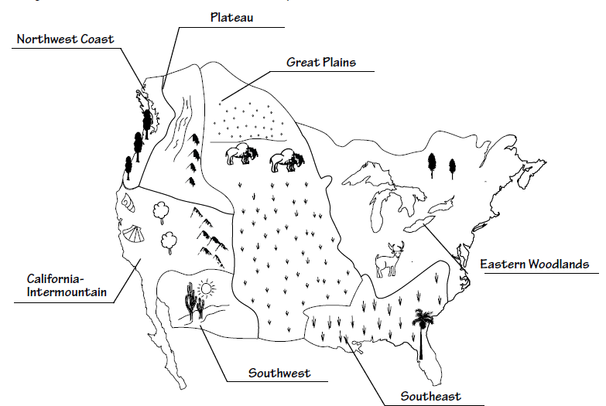
Map

Slide 3
Northwest Coast 3.2
Region: Northwest Coast (Color the trees)
Tribes: Tlingits, Chinooks, Kwakiutls
Artifacts: (possible answers)
• wood house with cedar totem poles: constructed
from local cedar trees
• waterproof cedar-bark clothing: used plentiful
cedar bark for protection against rain
• cedar and willow fish trap: made from local
cedar and willow trees; used to catch salmon.

Slide 4
California- Intermountain 3.3
Region: California-Intermountain (Color the
trees, mountains, and shells.)
Tribes: Shoshones, Paiutes, Miwoks, Pomos
Artifacts: (possible answers)
• cone-shaped redwood home: used the available
redwood trees
• clamshell beads on cord: used clamshells
from the ocean as money
• grass basket decorated with shells, beads,
and feathers: used available grass, shells,
and feathers

Slide 5
Southwest 3.4
Region: Southwest (Color the desert, plants,
and sun.)
Tribes: Apaches Anasazis, Hopis
Artifacts: (possible answers)
• adobe pueblo apartments: used available
clay because trees were scarce
• woven cotton clothing: cotton was comfortable
and cool in hot weather; local plants
available to dye cloth.
• clay pots for storing food: used available
clay

Slide 6
Plateau 3.5
Region: Plateau (Color the river and mountains.)
Tribes: Nez Perce, Spokanes, Yakimas
Artifacts: (possible answers)
• underground winter home: built partially
underground for protection from the cold;
used grass because wood was scarce
woven-grass basket hat: made from available
grasses
• tool for digging roots: made from available
animal parts and wood; used to dig up camas
root .

Slide 7
Great Plains 3.6
Region: Great Plains (Color the plants and buffalo)
Tribes: Cheyennes, Pawnees, Comanches, Sioux
Artifacts: (possible answers)
• buffalo-hide tepee: used available buffalo
• buffalo-hide blanket: used available buffalo
• buffalo-hide shield: used available buffalo

Slide 8
Eastern Woodlands 3.7
Region: Eastern Woodlands (Color the lakes,
trees, and deer.)
Tribes: Iroquois (Mohawks, Senecas);
Algonquins (Mohegans, Delawares)
Artifacts: (possible answers)
• birch-bark summer wigwam: used available
birch trees
• turkey-feather cape: used wild turkeys
• cedar and birch-bark canoe: made from
available trees; light so they could be easily
carried from one of the many streams to
another

Slide 9
Southwest 3.8
Region: Southeast (Color the plants and palm tree)
Tribes: Creeks, Choctaws, Seminoles
Artifacts: (possible answers)
• palm-leaf chickee built on platform; used palm trees; platform protected home from wet
ground; no walls because of hot weather
• deerskin leggings: from animal hides; gave protection from mosquitoes and saw grass
• flat bottom dugout canoe: made from trees; used bones and stones as tools; flat bottom for
use in shallow swamp waters

